Slide 1

Agile Thinking: Deciding to Teach Every Student
    Rhonda Bondie
    Harvard Graduate School of Education
    rhonda_bondie@gse.harvard.edu

Slide 2
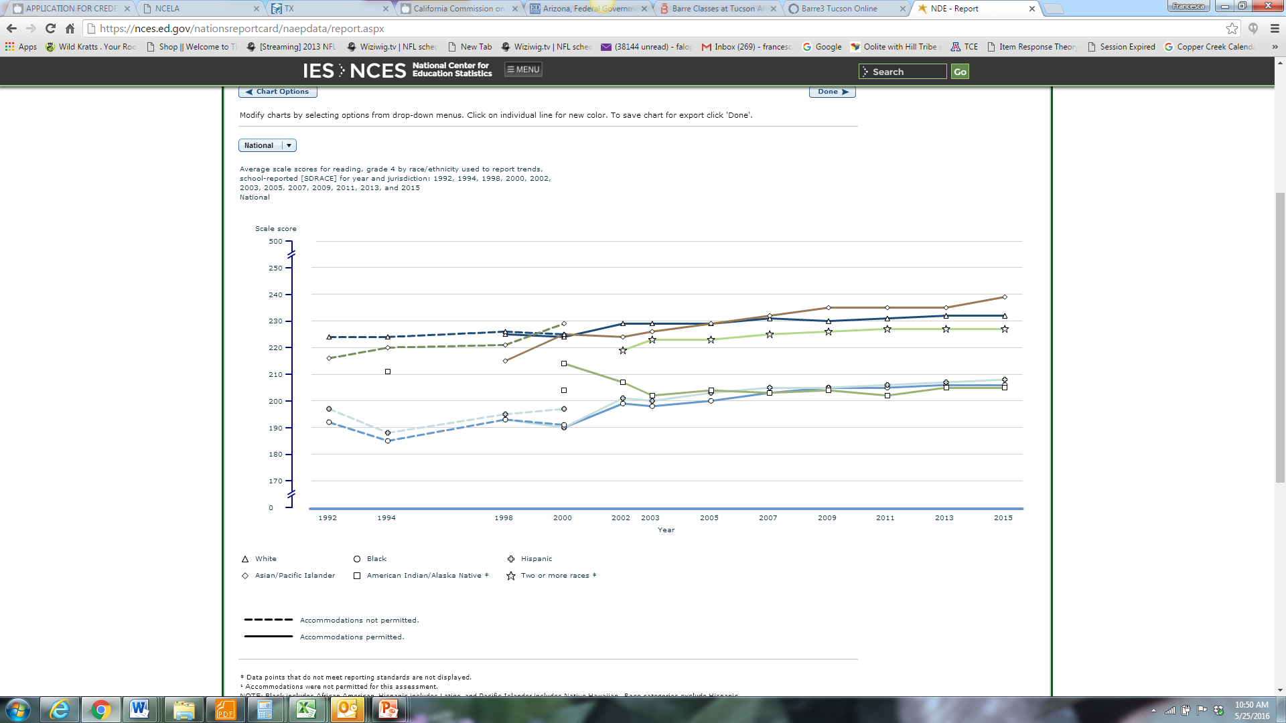
4th grade Reading NAEP

Slide 3

Agile Thinking: Deciding to Teach Every Learner

Slide 4
A Model for How Teachers Use Agile Thinking to Make Instructional Decisions
Perceive
student strengths & needs
Reflect
measure impact of instruction on student learning
Synthesize
knowledge to determine
learning needs
Rapid, flexible,
culturally affirming instructional decisions
Imagine
multiple instructional responses
Adjust
instruction

Slide 5
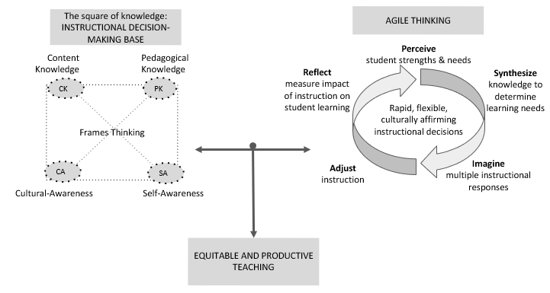
Taken Together the Instructional Decision-Making Base along with Teacher Use of Agile Thinking Results in Equitable Productive Teaching

Slide 6
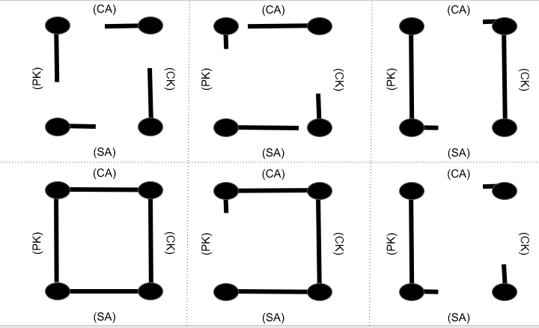
The Instructional Base of Every Teacher is Different and Changes throughout a Teacher’s Career

Slide 7
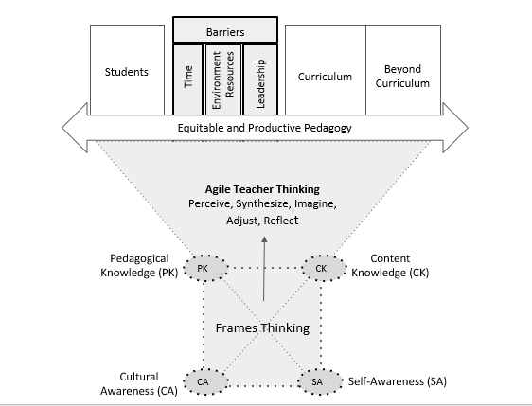
The Instructional Base Supports Teacher Agile Thinking that is used to Move Students beyond Barriers including Time, Environment, Resources, and Perceptions of Leadership to Learning the Curriculum and Extending Beyond the Curriculum

