Slide 1
Developing Elementary Teachers’ Ability to Facilitate Discussions in Science and Mathematics Via Simulated Classroom Environment (Go Discuss)
Project Leads: Jamie Mikeska, Heather Howell (Educational Testing Service), Carrie Straub (Mursion)
Presented at The Simulations in Teacher Education Conference In Louisville KY, February 2019

Slide 2

Overview of the Project
4 year research and development grant funded under the NSF DRK-12 program (Grant No. 1621344)
Development and piloting of performance tasks to support pre-service teacher (PST) learning of how to facilitate small-group discussions
Research focused on
Teacher educator use of such tools in methods courses
Measuring and understanding PST improvement over time with respect to the target teaching practice
Collecting evidence of task validity for formative use
Copyright C 2016 by Educational Testing Service. All rights reserved ETS, the ETS logo and MEASURING THE POWER OF LEARNING are registered trademarks of Educational Testing Service (ETS). All other trademarks are property of their respective owners. 36085

Slide 3

Situating the work
Theoretical Framework: Grossman
Teaching Practice: Content-intensive argumentation-focused group discussions (Rationales: important, difficult, rare
Keywords: Science & Mathematics Education, Pre-Service Teacher (PST) Preparation, Digitally-Mediated (Mursion), Formative Assessment
Simulator use: 20 minute individually taught lesson outside of class; five 5th grade students, lesson focus provided in advance
Model in which simulator use is embedded:
3 cycles within a methods course
For each cycle, the PST receives video, written feedback, class debrief activity each time.
Teacher Educator has access to all videos, feedback and scores
Also a pre/post measure

Slide 4
Elements of Approximation
Higher fidelity:
Time (continuous)
Time (relatively short)
Individual teaching
Authenticity of student work/responses
Students look and sound like avatars of children
Lower fidelity:
Need to address classroom management
Absence of “launch”
Inability to select the student-level task
Affordance of ample time to prepare
Students look and sound like avatars of children
Other constraints of the digital environment (unable to move, regroup, etc.)

Slide 5

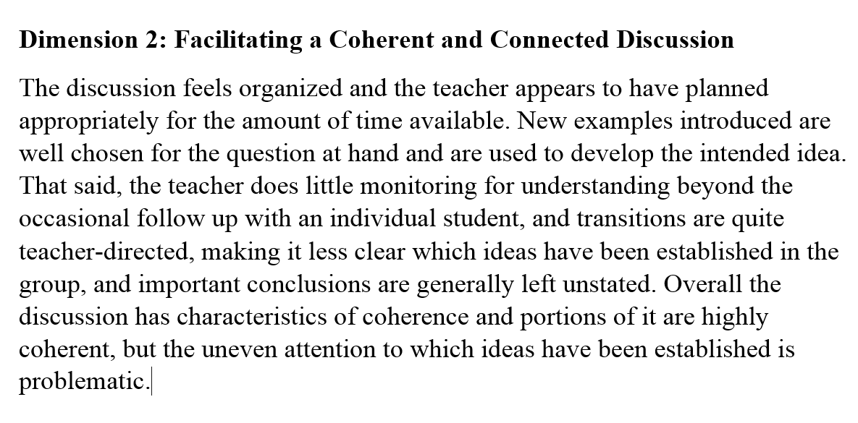
The Simulation in Context
The Formative Cycle
Discussion
Reflection
Feedback
Copyright © 2018 by Educational Testing Service. All rights reserved. ETS and the ETS logo are registered trademarks of Educational Testing Service (ETS). MEASURING THE POWER OF LEARNING is a trademark of ETS. 30141

Slide 6
Theory of Action for PST Learning through Formative Assessment
Primary learning mechanism for PSTs is through cycles of formative feedback to PST and TE
Written feedback (PST & TE)
Score information and ability to compare (TE)
Reflection (PST & TE)
Next instructional steps in the methods course
Secondary mechanisms include
Feedback loops within the teaching session (e.g., students engage (or do not) in peer to peer dialogue, students learn or do not learn)
Comparability of teaching performances
Tasks as representations of practice

Slide 7
Implications of Focus on Formative Assessment
Purposes are formative
PST Learning is ultimate goal
TE is informed and makes instructional choices
Activity is a form of assessment because…
Grain size of simulation component
Nature of the information provided to the TE
How the simulation is enacted
Time and individuality are approximated with fidelity
Standardization of opportunity is a key focus of task development

Slide 8
Closing Questions
(How) does grain size matter in hypothesized learning trajectories?
How can we talk in productive ways across cycles of enactment or theories of action that look similar and may be quite different?
(How) does standardization of opportunity matter?
For which use cases is comparability of information useful?
How standardized is standardized enough for which purposes and how do we achieve it and provide evidence that we are doing so?
Where might standardization of opportunity be a hindrance?
(How) are these considerations content-specific?

Slide 9
This study was supported by a grant from the National Science Foundation (Award No. 1621344). The opinions expressed herein are those of the authors and not the funding agency.

