Slide 1

Simulations as Approximations of Practice: New Ways to Understand and Improve Teaching
Dr. Julie Cohen
University of Virginia, Curry School of Education and Human Development

Slide 2

Overview
Why simulations?
The what and the how
An example study
Theory and methods
Possible implications
Questions and challenges
Next steps for research

Slide 3
High-Quality Teaching from Day 1 And Beyond
Steep returns to experience in early years (Atteberry et al., 2015)
Questions of readiness
Learning “on the job”
How can teacher education programs prepare novices who are ready to provide ambitious instruction on their first day in the classroom?
Plateau of improvement mid-career? (Kraft & Papay, 2014)
Opportunities for practice (with feedback?) throughout a career
How can ongoing professional learning opportunities focus directly on improving practice?

Slide 4





Practice-Based Teacher Education
Focus teacher preparation on “the work of teaching” (Ball & Forzani, 2014)
Content- what is the work of teaching?
49 techniques (Lemov, 2010)
“High-leverage” or “core” practices (McDonald, Kazemi, & Kavanagh, 2013)
HLP’s for special education, EL’s
Same leverage across students?

Slide 5
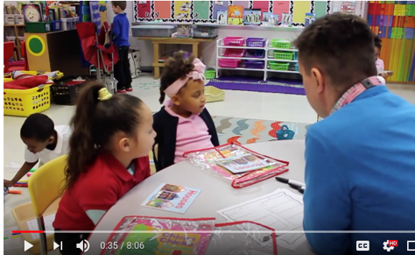
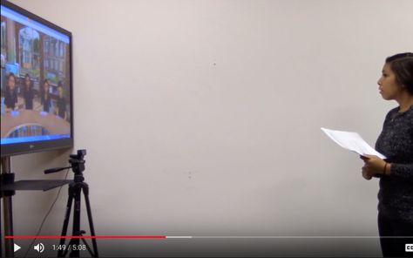
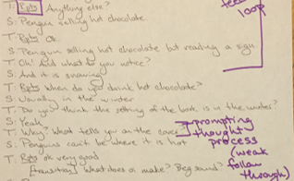
Professional Practice through Representations of Practice
Representation
Approximation
Decomposition

Slide 6
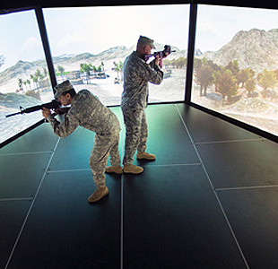
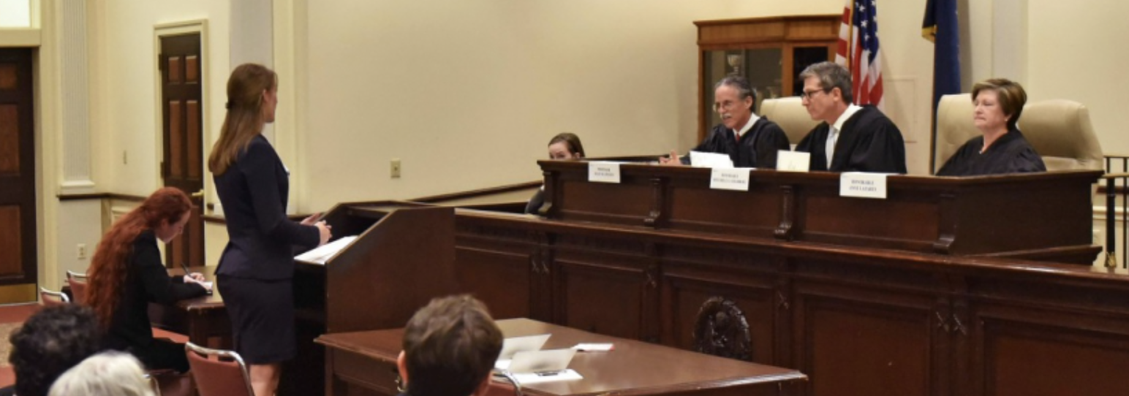
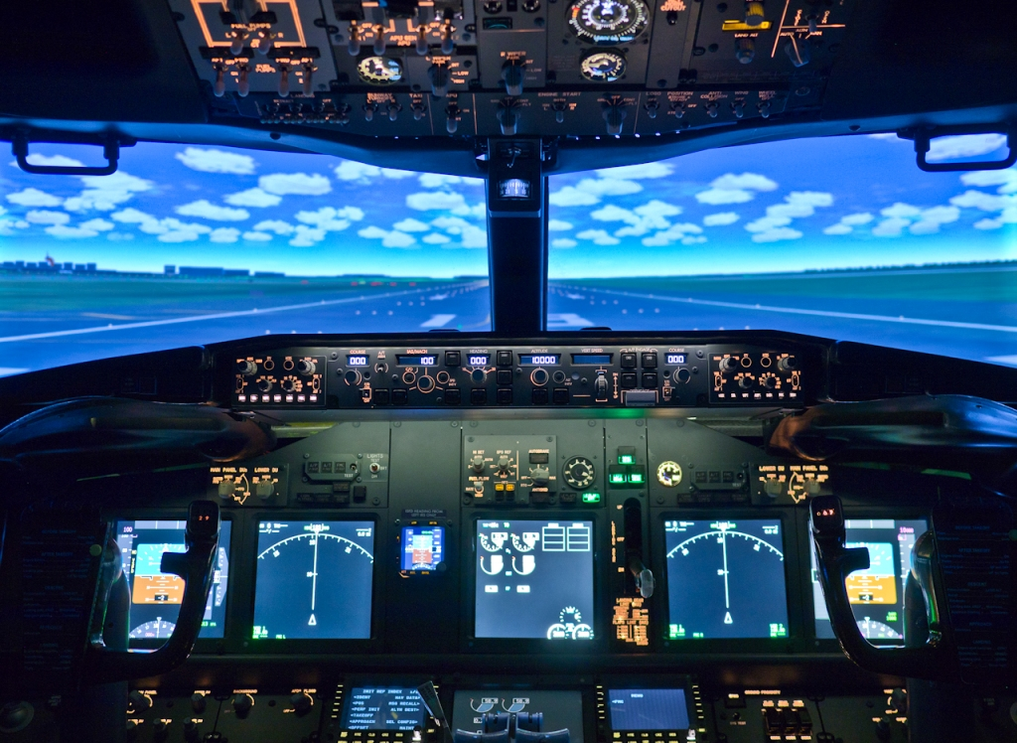

Simulations Across Professions

Slide 7
Turn and Talk
What is “worth” approximating and why?
Core and high leverage practices as guide posts?
Frequency and transfer

Slide 8
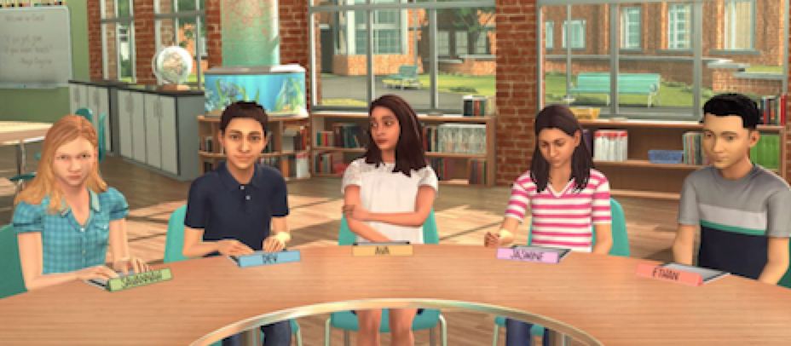
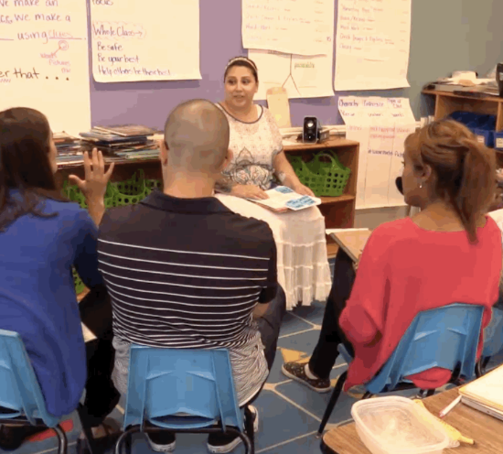
Different Simulations For Teaching

Slide 9
Teacher Candidates’ Perceptions
Immediate Feedback
“It is so beneficial to get the instant response to how it went. In my placement, I just play things over in my head. My mentor teacher is just mostly positive. Here I get other people’s take on my teaching.”
Opportunities for “do overs”
“You don't usually get the chance to redo the same lesson until the following year. Having the opportunity to do so let me improve in real time.”
“Low stakes” practice opportunity
“You can practice with no risk of actually doing any harm to a real student. If you mess up, you can just change it without also messing up a kid’s life.”

Slide 10
Teacher Educator Perspectives
Prompting reflection for teachers
“Students could practice, reflect on, and receive immediate feedback on discrete skills, which they don’t always get in the field.”
Opportunity for customization
“I was able to observe what each one of my candidates needed and give them support on those specific skills.”
Reduce the complexity of classroom scenarios
“Very early in the program we can practice specific, discrete skills, one at a time.”
Access to both common and less typical scenarios
“They will all have to facilitate parent-teacher conferences, but the mentor teacher will always lead them in student teaching. Practicing this way, where they are the lead, is vital.”

Slide 11
Back to the Future?
Microteaching revisited
Atheoretical
Focus on what “works”
Teaching as technical rather than professional work
Building a theory of simulations that….
Capitalizes on knowledge about how professionals learn
Maintains the complexity of teaching practice- reliant on professional knowledge and skill
Provides differential access points and trajectories of development

Slide 12
An example study….

Slide 13
Simulated Scenario and Background
6th grade level text, “A Dangerous Game”
Feedback during text-based discussion
Text-based inference and argumentation
Simulation specialist trained to provide same, scripted responses across candidates
Completed pre-simulation activity:
Exemplar responses to text-based questions
Evidence from text to support answer
Anticipated student responses
Possible feedback responses to support student understanding of text

Slide 14
Simulations in Action
Link-https://www.youtube.com/watch?v=tokdKVhGB4M&feature=youtu.be

Slide 15
Turn and Talk (2)
What might a teacher educator learn about this candidate by watching this approximation?
What might remain invisible about the candidate’s developing practice based on this approximation?

Slide 16
Scaffolding Practice
Link-https://www.youtube.com/watch?v=tokdKVhGB4M&feature=youtu.be

Slide 17
Turn and Talk (3)
How much does the technology “matter” in this simulation?
Would teacher learning look different in….
A whole class rehearsal?
Partner role plays?
Working with a standardized student?

Slide 18
Theory of Change
Practice Based Methods Courses
Candidate
Characteristics
Simulator Teaching
Coaching
Simulator Teaching
Classroom Teaching
Pre-Simulator Activity
Buy in and Engagement with Simulator

Slide 19
What if?
Practice Based Methods Courses
Simulator Teaching
Simulator Teaching
Classroom Teaching
Pre-Simulator Activity

Slide 20
What if? cont’d
Coaching
Practice Based Methods Courses
Whole Class Rehearsals
Whole Class Rehearsals
Classroom Teaching

Slide 21
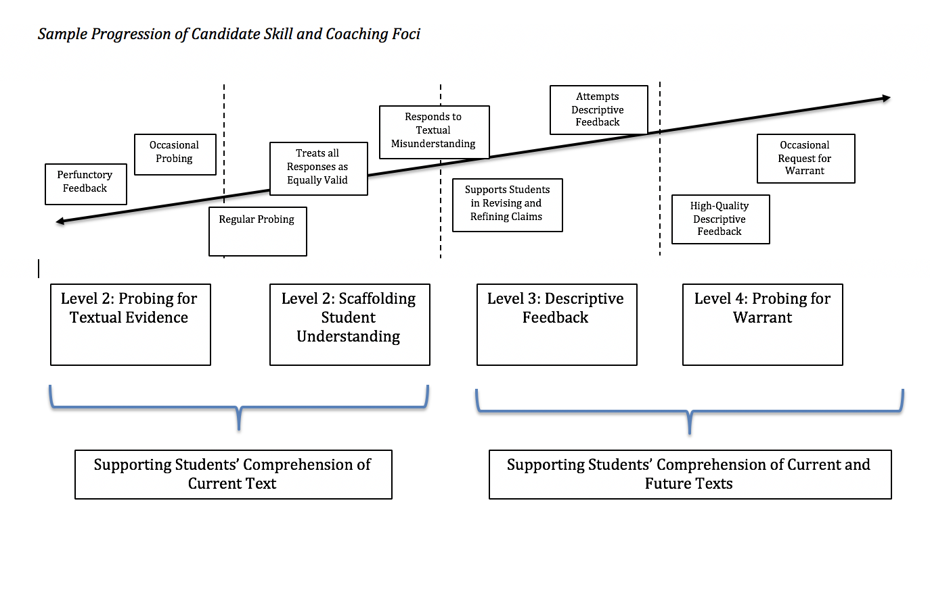
Sample Progression of Candidate Skill and Coaching Foci

Slide 22
Study Design – Overview
Sample:
121 Teacher Ed Candidates
Elementary Ed 1
(n=32)
Elementary Ed 2
(n=32)
Secondary Ed 1
(n=32)
Secondary Ed 2
(n=25)
RA
RA
RA
RA
Self-Reflect
(n=11)
Coach (n=11)
Coach
+
Bug in Ear
(n=10)
Self-Reflect
(n=11)
Coach
(n=11)
Coach
+
Bug in Ear
(n=10)
Self-Reflect
(n=10)
Coach
(n=11)
Coach
+
Bug in Ear
(n=11)
Self-Reflect
(n=8)
Coach
(n=8)
Coach
+
Bug in Ear
(n=9)

Slide 23
Treatment Conditions
 |  | Control Condition |  | Treatment 1 |  | Treatment 2
Simulation Session 1 |  | ----- |  | ----- |  | "Bug in the Ear"
Treatment |  | Self Reflection |  | Coaching |  | Coaching
Simulation Session 2 |  | ----- |  | ----- |  | -----

Slide 24
Data Collection and Analysis
Detailed data about candidates
Surveys before and after sessions
Transcripts of all simulation sessions
Human coding with rubrics
Computational linguistic analyses and readily accessible information for candidates
Tools for coaches
Protocols with theories of candidate development with respect to focal practice

Slide 25
Zooming back out

Slide 26
Approximations as a Tool for Research
Different kinds of questions than is typical in research on teacher education
Holding content and students constant can make aspects of practice more salient
Observing the development of practice in real time
Rapid prototyping and improving interventions
Simulations as diagnostic spaces
Differentiation for teachers across contexts, over time
Moving from a one-size-fits-all model
Individualization and targeted support- improve efficiency
Pre-service, induction, and beyond

Slide 27
Turns and Talk (4)
When are approximations helpful?
For whom?
Under what conditions?

Slide 28
Lingering Questions
Sequence of skill development and timing of approximations
Do some aspects of practice improve more readily than others?
Informing scope and sequence of teacher education curriculum
Connections to induction programs- trajectory of development over time and across contexts
Lock chains of proficiency?
Badges, microcredentials
Scope and sequence

Slide 29
Lingering Questions cont’d
Transfer
Relationship between teaching in simulated settings and teaching in K-12 classrooms
Affordances in terms of internal validity
Questions about external validity
What is marginalized when we focus on observable practice?
Beliefs?
Identity?
Students?

Slide 30
Last Thoughts Before Dinner
Building consortia for sharing materials and data
Casebooks of simulations and associated materials for simulation specialists, coaches, and candidates
Learning across different types of approximations
Replicating studies
Multiple sites
Varied populations of prospective and in service teachers

Slide 31
Questions?
Julie Cohen, jjc7f@virginia.edu

