Slide 1

Learning to Notice Elementary Students’ Ideas and Use of Science Practices in Tool-Supported Rehearsals
Amanda “Mandy” Benedict-Chambers

Slide 2
Focus of this Work
Using tool-supported rehearsals to support elementary preservice teachers’ noticing and to approximate the high-leverage practice of eliciting, probing, and developing students’ ideas and use of science practices in a science methods course

Slide 3
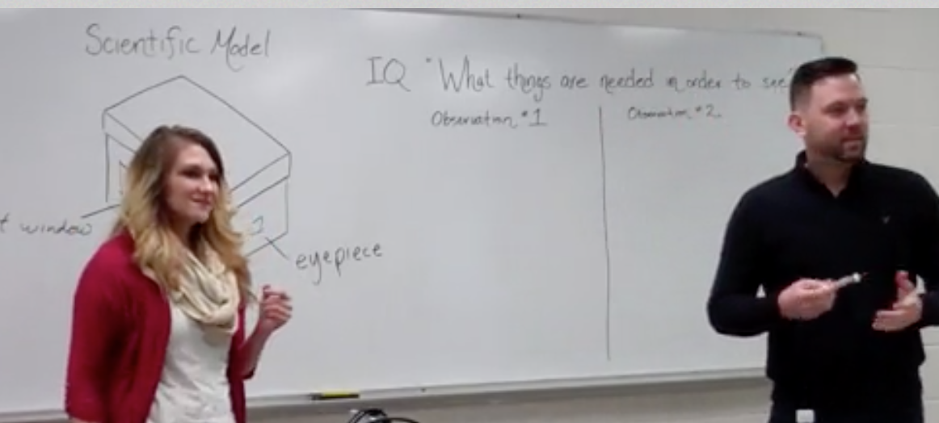
Project Overview
Preservice teachers (PSTs) on a teaching team teach science lessons to the whole class in rehearsals in a science methods course
Peers simulate elementary students with alternative conceptions and science practice challenges during the rehearsal; they also offer feedback after the rehearsal
Teacher educator also role plays elementary student thinking and offers feedback during and after the rehearsal

Slide 4
Theory of Action: Noticing
The ability to notice and critically analyze important features of one’s practice is emphasized in recent reforms in science and mathematics education (AAAS, 1993; National Council of Teachers of Mathematics [NCTM], 2000; NGSS Lead States, 2013).
Elementary science preservice teachers need to learn to notice student ideas and students’ use of science practices (NGSS, 2013).
Teacher noticing involves: (a) attending to students’ ideas and strategies; (b) using evidence of students’ understandings to interpret instruction; and (c) deciding how to respond on the basis of students’ understandings (Jacobs, Lamb, & Philipp, 2010; van Es, Cashen, Barnhart, & Auger, 2017).
However, classrooms are complex, busy settings and preservice teachers may struggle to know what is important to focus on and how to interpret what they see (van Es et al, 2017).

Slide 5
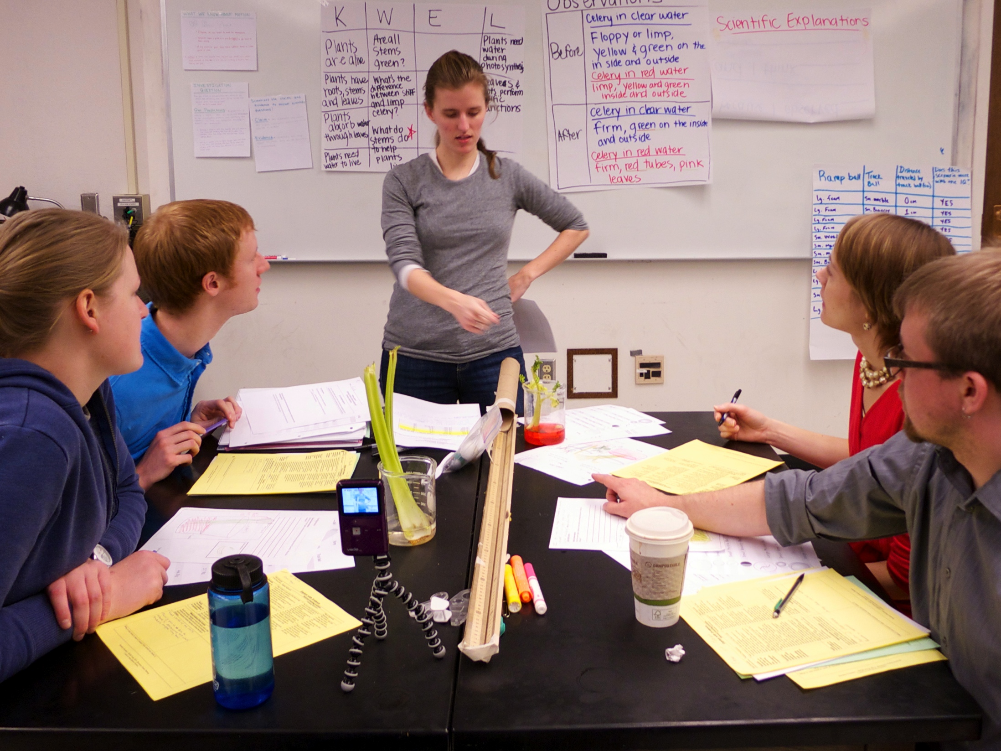
Theory of Action: Rehearsals
Rehearsals can provide opportunities for PSTs to learn to notice in a context, such as a methods course, that is less authentic and less complex than the busy classroom setting.
The rehearsal (Lampert, Franke, Kazemi, Ghousseini, Turrou, Cunard, Crowe, 2013) is a pedagogical approach that draws on representations, decompositions, and approximations of practice (Grossman el al, 2009).
Tools can support teacher learning and noticing in rehearsals and enhance the work of representing, decomposing and approximating practice.

Slide 6
Theory of Action: Tools
Tools, such as video recordings of instruction or teaching frameworks, can serve as representations of practice.
Tools, such as lists of alternative student ideas about a concept, can serve to decompose practice and support PSTs to see important features of instruction (student thinking) that might otherwise not be obvious to novices.
Tools, to guide the actions of teachers and simulated students in rehearsals, support PSTs in approximating the complex work of noticing and working with elementary student ideas and use of science practices in the safe space of a methods classroom.

Slide 7
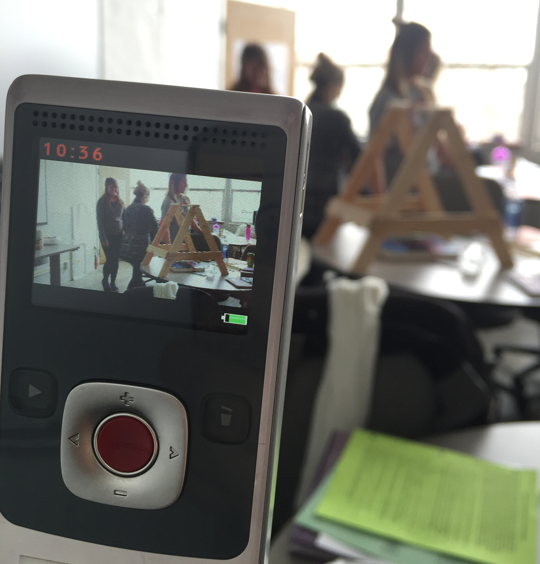
RQ: How do preservice teachers describe the role of the tools with the rehearsals in helping them to notice student ideas and students’ use of science practices?
Methods
Interviewed 5 PSTs 4 times about their tool use before, during, and after Engage, Explore, Explain rehearsals and a classroom lesson (20 interviews)
Coded each interview question and response (Miles, Huberman, & Saldaña, 2014) and looked for commonalities and discrepancies in how the PSTs discussed their tool use before, during, and after the instruction

Slide 8
Initial hypothesis about how tools might support PSTs’ noticing of students’ ideas and use of science practices in rehearsals
Tools | Priming Teacher Tool (Supporting noticing before rehearsals) (Windschitl, Thompson, Braaten, & Stroupe, 2012) | Face-to-Face Teacher Tool (Supporting noticing during rehearsals) (Windschitl, Thompson, Braaten, & Stroupe, 2012) | Reflection Teacher Tool (Supporting noticing after rehearsals) (Davis, 2006; Rodgers, 2002)
EEE Framework | Helps teachers plan core practices that support student learning | Supports teachers as they use core practices during the lesson | Supports teachers as they reflect on their enactment of core practices
Student Alternative Ideas + Explanations | Helps teachers to plan for and prepare to work with students’ ideas
Science Practice Challenges | Helps teachers to plan for and prepare to work with students’ science practice challenges
EEE Framework Feedback Form | Helps teachers consider different proficiency levels of science teaching |  | Helps teachers reflect on different levels of science teaching

Slide 9
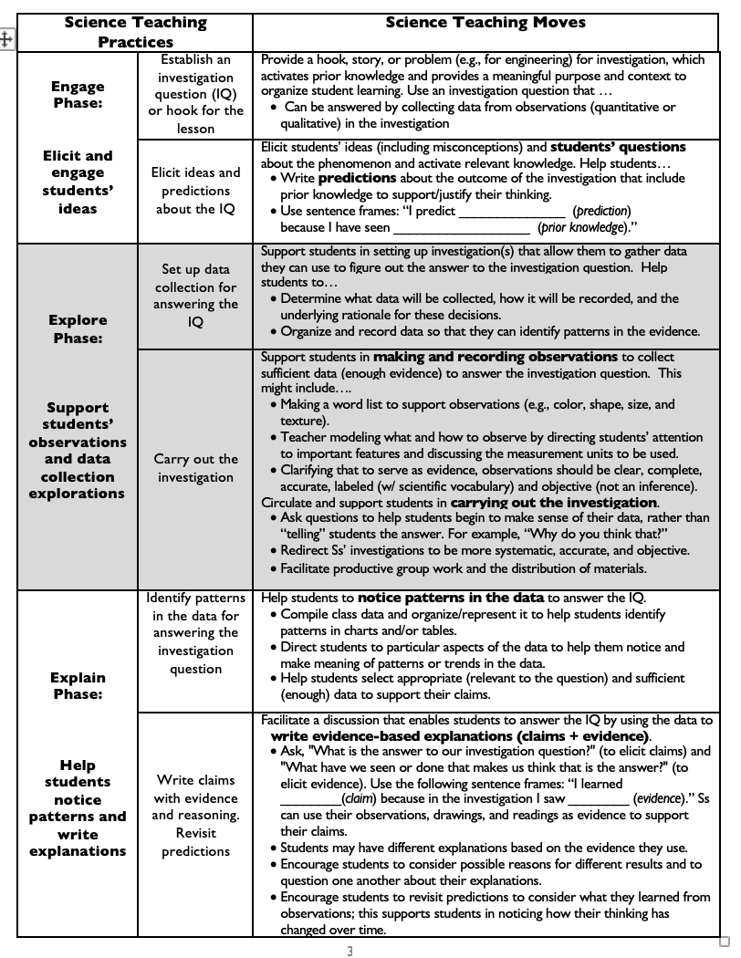
Engage-Explore-Explain (EEE) Framework
(Benedict-Chambers, 2014; Davis, 2016)

Slide 10
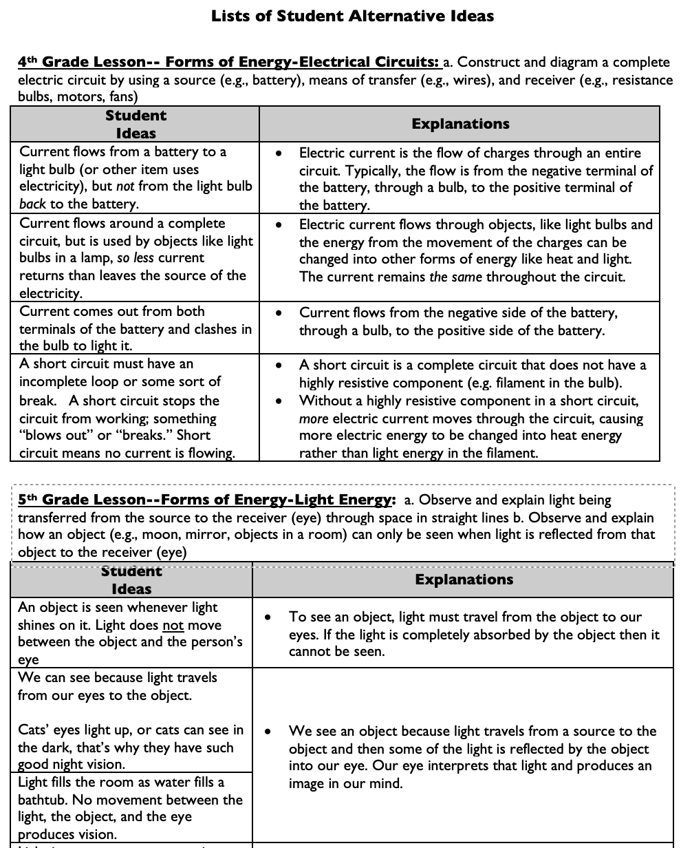
Student Alternative Ideas + Explanations Tool
(Benedict-Chambers & Aram, 2017; Fick & Arias, in press; Kademian & Davis, in press)

Slide 11
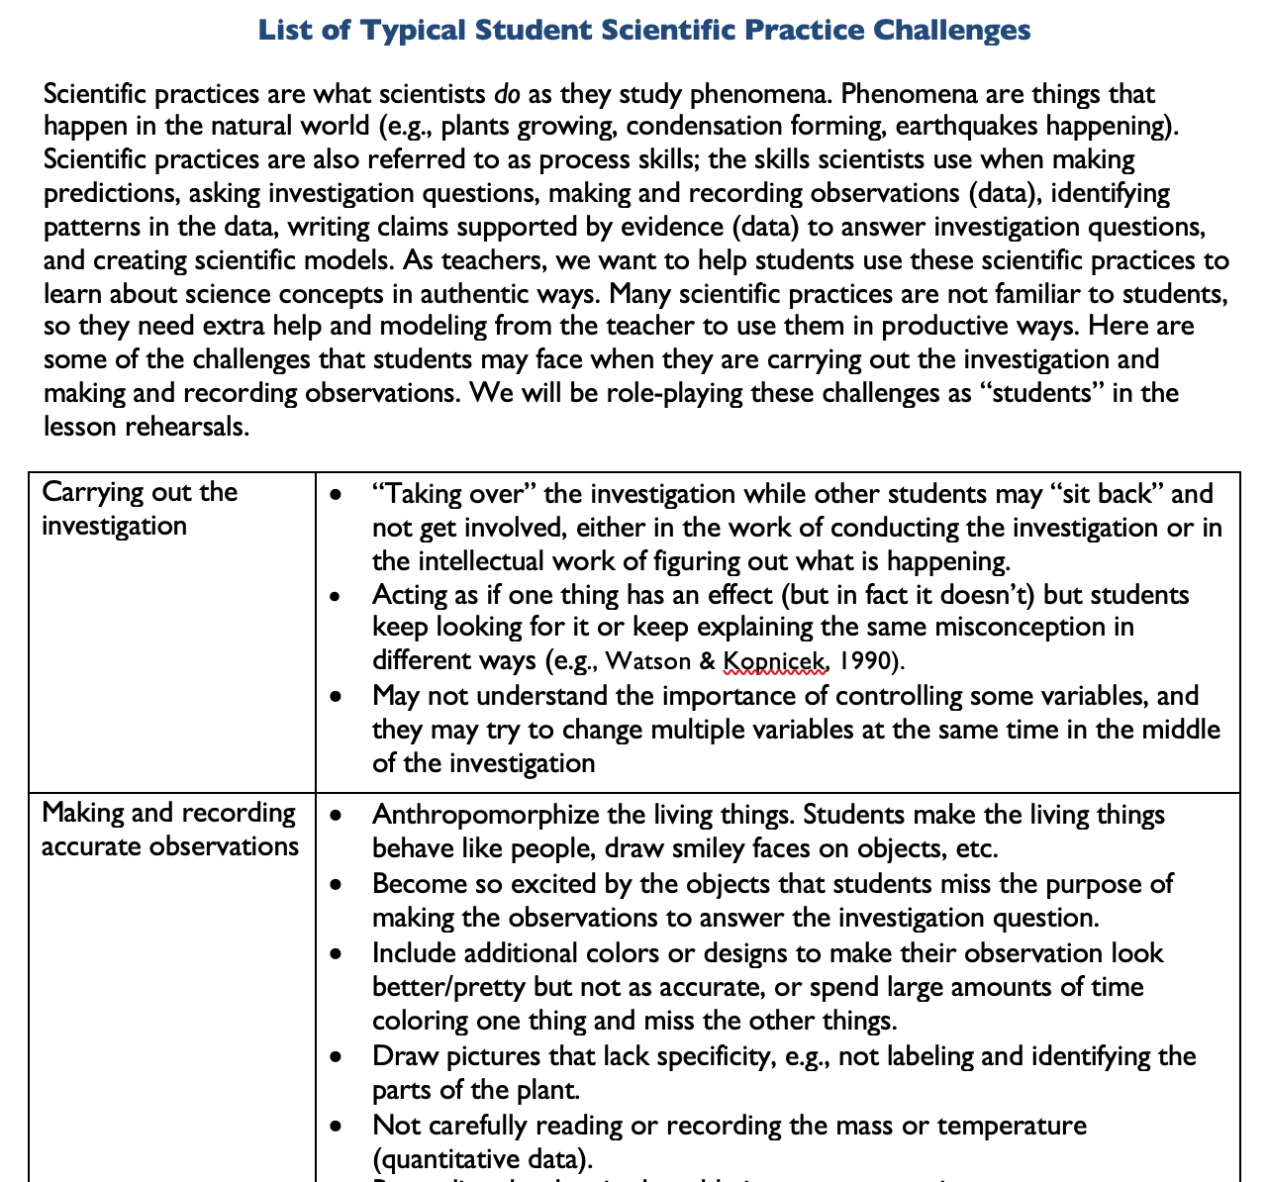
Science Practice Challenges Tool
(Benedict-Chambers & Aram, 2017; Fick & Arias, in press; Kademian & Davis, in press)

Slide 12
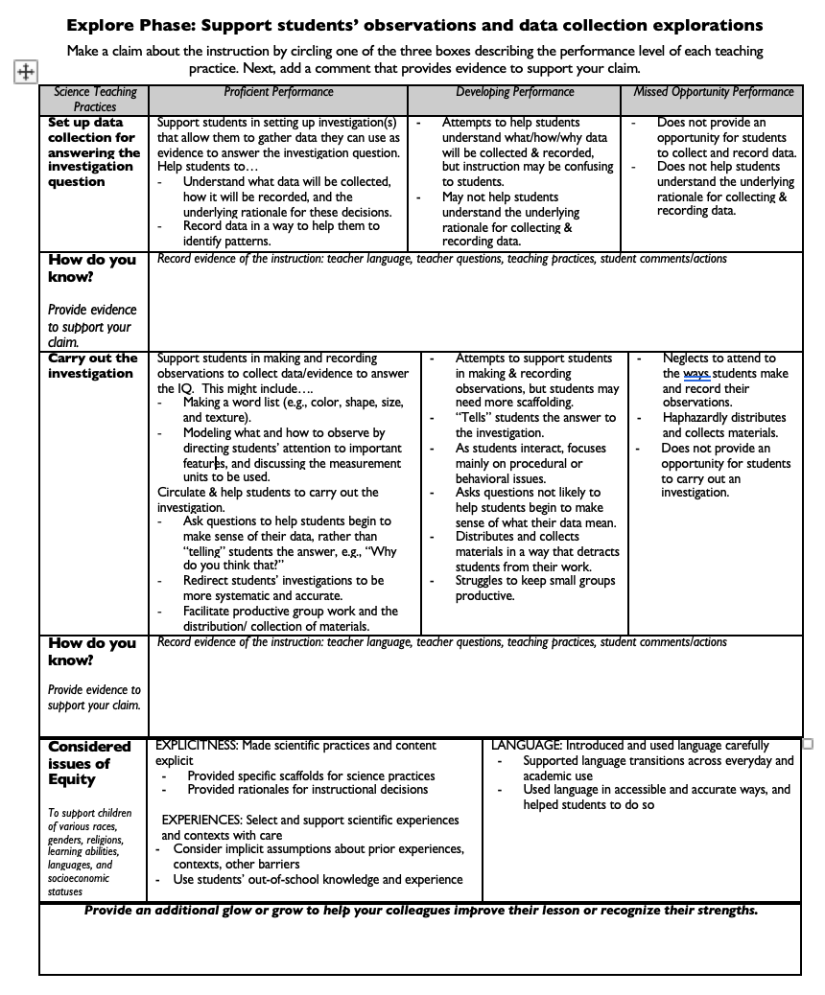
EEE Feedback Form
(Benedict-Chambers, 2016; Fick & Arias, in press; Kademian & Davis, in press)

Slide 13
Learnings: PSTs’ Tool Use with Rehearsals
Tools | Priming Teacher Tool (Supporting noticing before rehearsals) | Face-to-Face Tool (Supporting noticing during rehearsals) | Face-to-Face Tool (Supporting noticing during rehearsals) | Reflection Teacher Tool (Supporting noticing after rehearsals)
EEE Framework | Helps teachers plan core practices that support student learning | For Teachers: Supports teachers as they use core practices during the lesson |  | For Teachers: Supports teachers as they analyze their enactment of core practices
Student Alternative Ideas + Explanations | Helps teachers to plan for and prepare to work with students’ ideas | For Simulating Students: Supports teachers to respond to students’ ideas during instruction | For Simulating Students: Supports peers to respond as elementary students with alternative ideas | For Simulating Students: Supports teachers to analyze their questions and explanations in rehearsal video
Science Practice Challenges | Helps teachers to plan for and prepare to work with students’ science practice challenges |  | For Simulating Students: Supports peers to respond as elementary students who struggle to use science practices | For Simulating Students: Supports teachers to analyze their student work after the rehearsal

Slide 14
Learnings: PSTs’ Tool Use with Rehearsals continued
Tools | Priming Teacher Tool (Supporting noticing before rehearsals) | Face-to-Face Tool (Supporting noticing during rehearsals) | Face-to-Face Tool (Supporting noticing during rehearsals) | Reflection Teacher Tool (Supporting noticing after rehearsals)
EEE Framework Feedback | Helps teachers consider different proficiency levels of science teaching |  | For Simulating Students: Supports peers’ noticing of different proficiency levels of science teaching | For Teachers: Helps teachers reflect on different levels of science teaching
Lesson Artifacts of Student Thinking |  | For Simulating Students: Helps teachers to assess student thinking and science practice use during lesson | For Simulating Students: Helps peers to consider how elementary students’ might integrate the learning of disciplinary core ideas and science practices as they engage in instruction and complete student work | For Simulating Students: Helps teachers assess elementary students’ efforts to integrate the learning of disciplinary core ideas and science practices

Slide 15
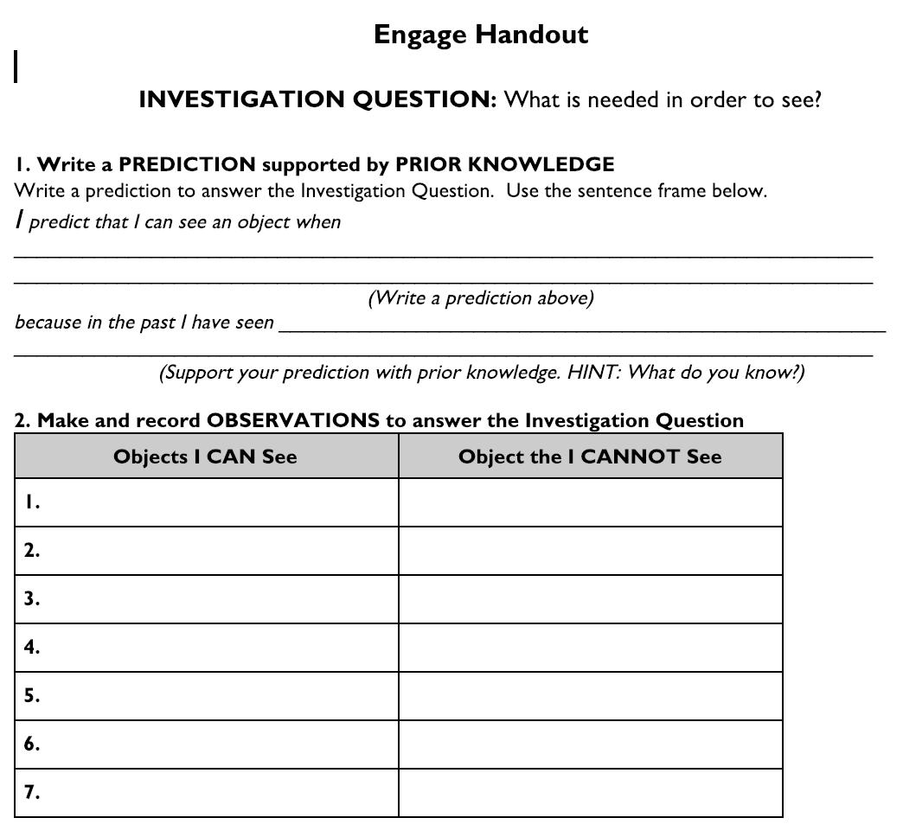
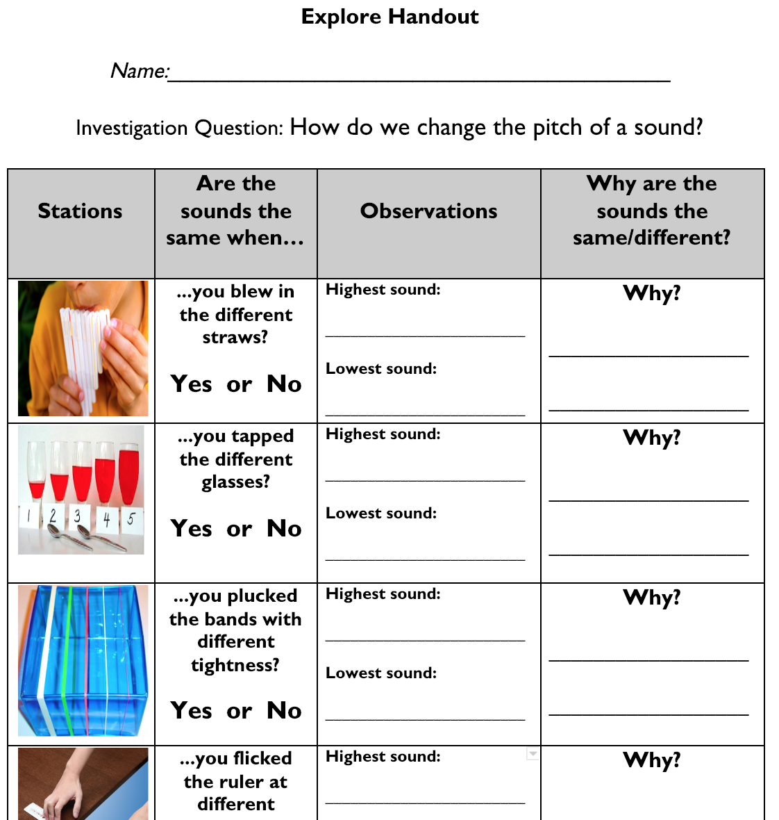
Lesson Artifacts of Student Thinking

Slide 16
Insights about Teacher Tools and Teacher Learning
The use of the student alternative ideas + explanations tool as a face-to-face tool during instruction suggests…
the PSTs might need additional scaffolds for learning how to respond to student thinking
The use of the student alternative ideas + explanation tool as a reflection tool when analyzing their teacher language in their rehearsal video suggests...
the PSTs might need additional scaffolds for developing their subject matter knowledge
The use of science practice challenges tool as a reflection tool to notice particular aspects of their students’ work (predictions, observations during investigation, explanations) after the rehearsal suggests…
the PSTs might need additional supports for making sense of their students’ use of science practices

Slide 17
Insights about “Student” Tools and Teacher Learning
The use of the simulating student tools to help the teachers’ peers consider how elementary students might integrate the learning of disciplinary core ideas and science practices suggests…
the simulating student tools helped to foster authentic teacher-student interactions
the simulating students learned about student thinking and science practice use as they role-played elementary students
PSTs wanted their peers to use the simulating student tools to have the opportunity to practice responding and analyzing students’ alternative ideas and challenges before lessons in classroom settings; were frustrated if their peers did not do so
PSTs valued the opportunity to simulate complex aspects of science teaching, receive feedback, and have the chance to have a do-over before classroom lessons

Slide 18
Future Directions & Questions
How do preservice teachers use the tools to notice and develop students’ ideas in classroom contexts?
Research should investigate the opportunities afforded or constrained by the simulating student tools
Do the simulating student tools engage the PSTs in a unique learning opportunity not afforded by virtual simulations? (where students are role-played by others)
Do the simulating student tools develop both the subject matter knowledge of the “students’” as they study the tools to respond to the instruction as well as the “teachers’” subject matter knowledge?
Is a basic level of subject matter knowledge required for the “students” to appropriately use the tools to simulate student thinking?

Slide 19
Thank you!
Mandy Benedict-Chambers
BenedictChambers@MissouriState.edu

