Slide 1

Simulated Student Interviews for Preservice Elementary Science Teaching
Anna Maria Arias, Kennesaw State University
Elizabeth A. Davis, University of Michigan

Slide 2
Elementary science teaching
Elementary science teaching involves integrating science practices (e.g., analyzing data) with science content (NGSS, 2013, NRC, 2012)
  Atypical yet possible in U.S. classrooms (Banilower, et al., 2013; Avraamidou & Zembal-Saul, 2010)
  Complex work to coordinate students, content, and context (Lampert, 2001)
Need strategies to gauge and support beginning teachers’ abilities

Slide 3
Our Questions
How might using a simulated student interaction enable us to learn more about elementary teachers' abilities to teach science?
What are the affordances or limitations compared to other approaches such as assessing written lesson plans?
→ What characterizes preservice teachers’ practice and knowledge to support students to analyze data and construct evidence-based claims during a simulated student interaction and in written lesson plans?

Slide 4
Theoretical Framework
Teaching as practice (Lampert, 2010; Ball & Forzani, 2009; Grossman & McDonald, 2008)
Learning to teach: distributed, situated, and social (Putnam & Borko, 2000)
A practice-based approach to teacher education
  Focus on high-leverage teaching practices (Ball & Forzani, 2009) and content knowledge for teaching (Ball, et al., 2009)

Slide 5
Theory of action
Actors, roles, and context
  Preservice teacher as “teacher”
  Teacher educator as “student” (and then as interviewer)
  Context: Information provided about previous work of the “class” along with investigative data collected by three “groups”
Features of teaching
  Two high-leverage practices—engaging students in analyzing data and supporting students in constructing evidence-based claims—and science knowledge for teaching
  Disciplinary core idea: conservation of mass
  “Student” struggles to see how the investigative data demonstrate conservation of mass
  “Teacher” needs to organize and represent three groups’ data, to allow the student to see patterns
Expected learning and assessment
  Simulation serves as a pre-assessment of strengths and abilities
  We expect the simulated interaction will complement and extend what we can learn from analysis of written work

Slide 6
Assessment versus opportunity to learn
Role of program assessments in our program
Implications for theory of action
  Actors and roles: Need an interviewer in addition to a simulated student
  Features of teaching: Because this is a pre-assessment, we don’t expect ideal performance, but do open space for two high-leverage teaching practices as well as content knowledge for teaching
We don’t build in opportunities for feedback because of the position in the program assessments – but with feedback, this experience could be a powerful lever for promoting preservice teacher learning

Slide 7
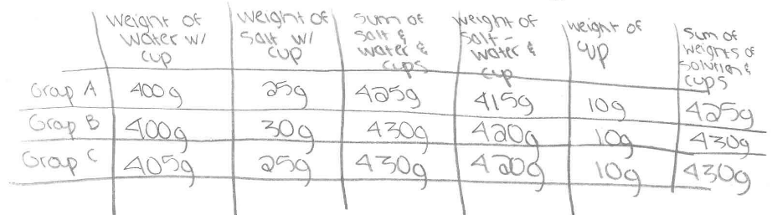
The Focal Teaching Practices and Knowledge
Supporting elementary students to analyze data
  Use a representation to analyze data
  Interpret representation to look for patterns or relationships

Slide 8
The Focal Teaching Practices and Knowledge (2)
Supporting elementary students to analyze data
  Use a representation to analyze data
  Interpret representation to look for patterns or relationships
Supporting students to construct evidence-based claims
  Make a claim to answer the investigation question
  Use evidence and reasoning to support the claim
I think ________ (claim). I think this because I saw _______ (evidence) . The reason for this is _________.

Slide 9
The Focal Teaching Practices and Knowledge (3)
Supporting elementary students to analyze data
  Use a representation to analyze data
  Interpret representation to look for patterns or relationships
Supporting students to construct evidence-based claims
  Make a claim to answer the investigation question
  Use evidence and reasoning to support the claim
Science Knowledge for Teaching
  Subject matter knowledge: conservation of mass
  Pedagogical content knowledge (students, strategies, etc.)

Slide 10
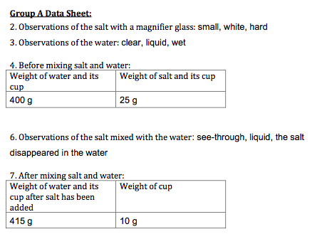
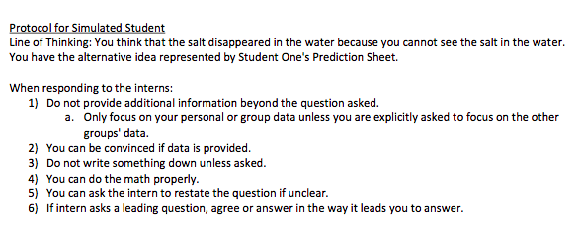
Interaction
Prompt: Support a student to make sense of the data collected by three groups during the investigation to answer the investigation question: “How does the weight of a solution compare to the weight of the materials used to make up the solution?”
Preservice teachers given time to prepare for the interaction ahead of time and then interact with the student
Simulated students have a protocol for responding to the student
Followed by a short interview.

Slide 11
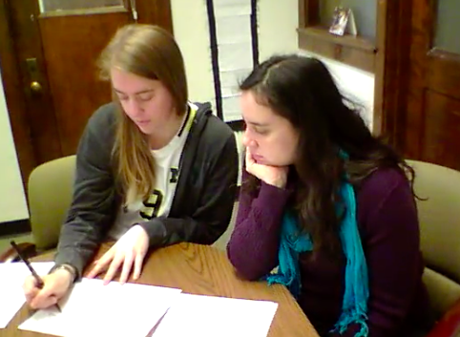
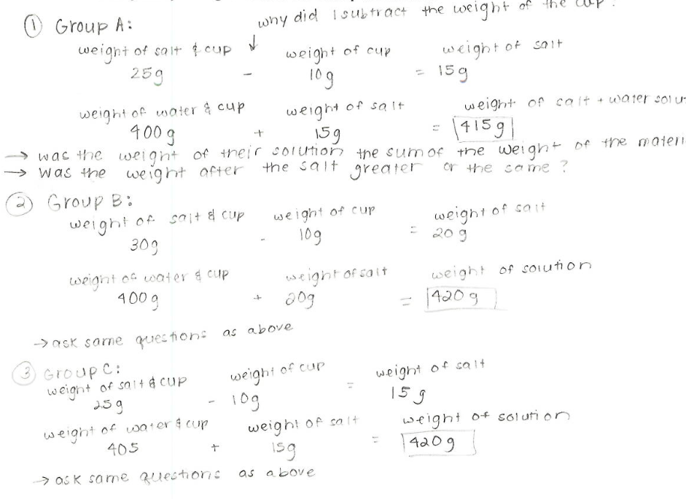
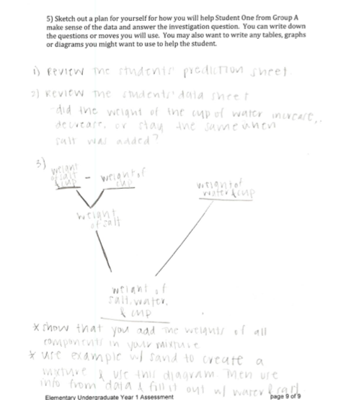
Overview of methods
Qualitative case study (Miles, Huberman & Saldana, 2014)
  Teaching practice and knowledge of 22 preservice elementary teachers
  Lesson plans and videorecords of simulated student interaction from all 22 preservice teachers

Slide 12
Findings
Strengths and struggles in the preservice teachers’ practice and knowledge
  Supporting students in analyzing data
  Supporting students to construct evidence-based claims
  Demonstrating science knowledge for teaching

Slide 13
Findings cont’d
Strengths and struggles in the preservice teachers’ practice and knowledge
  Supporting students in analyzing data
  Supporting students to construct evidence-based claims
  Demonstrating science knowledge for teaching

Slide 14
Supporting students to construct evidence-based claims
Strengths: Connecting claims to evidence (data) from the investigation
Struggles: Using sufficient evidence to support a claim; supporting student reasoning about how and why the evidence connects to the claim
Implications: Preservice teachers may need support in learning what constitutes adequate support for a claim. They have strengths to build on with regard to an inclination toward using evidence.

Slide 15
Take-aways
Highlights the complex nature of learning to teach – for example:
  A brief simulation explores and untangles two high-leverage science teaching practices and science knowledge for teaching
Potential and limitations of simulated individual pedagogy
  Allows for comparison across time and across preservice teachers
  Helps us prepare for the methods course
  Shows nuances in preservice teachers’ abilities such as doing intellectual work for students (not in our original theory of action, but seems important to characterize)
  Limited in authenticity and complexity of enacted practices
Missed opportunities for formative feedback
New work: Transforming assessment into opportunity to learn

Slide 16
Our lingering questions
Conceptual challenges
  Balancing between simulations as a learning experience and as an assessment
  Making valid characterizations of knowledge and practice
  Enhancing authenticity of the simulation
  Developing appropriate elementary science conceptual tasks
  Characterizing doing the intellectual work separately from the other dimensions of interest
  Characterizing plans versus enactments
Pragmatic challenges
  Training interviewers in enacting the the simulated interview protocol
  Ensuring consistency across interviewers
  Managing the logistics of running 30-50 interviews

Slide 17
Thank you to the preservice teacher participants.

